Slide 1
FIFA WC Prediction 2018
Team Name : Win FIFA
Members :
Debashish Bhattacharya
Madhura Kelkar
Aditya Menon
Jaitra Chakraborti

Slide 2
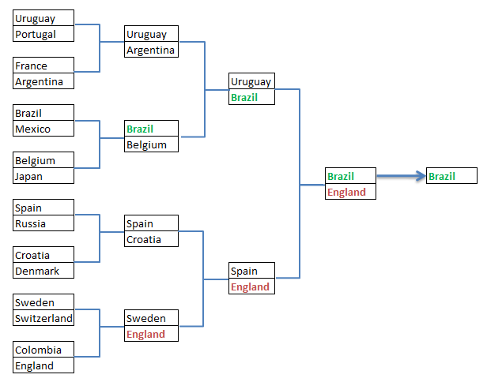
Prediction

Slide 3
Driving Factors
Saves_per_game
Goals_conceded_per_game
Goals_per_game
Shots_per_game
Shot_on_target_per_game
Shots_on_target_per_shot
Fouls_per_game
Fouls_suffered_per_game
Avg_substitution_per_game
Average_half_time_goals
Avg_red_card_per_game
Average_yellow_card_per_game
#_Top_4_finish
#_Top_2_finish
#_Winner
Points_after_group_stage

Slide 4
Model Creation
After the variables impacting the result were selected, data for each of these variables were obtained from different sources
The data was obtained from the FIFA and espn site (sample link for 1 country from the espn site provided in the next site)
As the data here was at the player level, the result had to be aggregated to the country level eg: adding the goals, shots, saves, fouls by each player to get the total for the team.
To verify the correctness of the data, they were tallied from the FIFA site and in case of data not available in the ESPN site, it was searched for in the FIFA site
The training data for building the model was based on the past World cup records –2014, 2010, 2006, 2002. Details for the editions before these were not available in these sites
The model created for Random Forest as it does in-sample testing which is helpful in case of samples with lesser records
The model was tested on the stats of the team for 1st 3 league stage games and the international friendlies held before the WC, as it provided the most recent trend
Based on the probabilities provided by the model and the draws of the next rounds, the winner and semi-finalists were predicted

Slide 5
Data Sets
Sources
ESPN - http://www.espn.in/football/team/squad/_/id/205?src=com
FIFA - https://www.google.co.in/search?q=FIFA&oq=FIFA&aqs=chrome..69i57j69i60l3j69i59l2.896j0j4&sourceid=chrome&ie=UTF-8#sie=lg;/m/06qjc4;2;/m/030q7;mt;fp;1

Slide 6
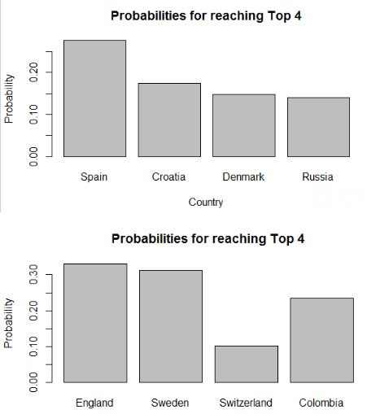
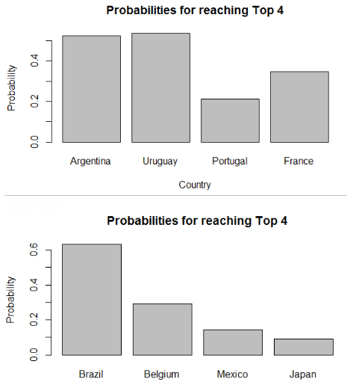
Probabilities

